Slide 1
Postoperative Care of the Cardiac Surgery Patient
Original: Kristen Valente BSN, RN-BC, ONC
2025 Update: Francis D. Cacacho, BSN, RN, CCRN

Slide 2
Objectives
Recognize the most common cardiac surgeries completed at VAPAHCS.
Recognize complications of Coronary Artery Bypass Surgery and TAVR surgery.
Recognize the signs and symptoms of cardiac tamponade.
Recognize when the patient needs to be paced.
Understand nursing interventions for patients after cardiac surgery.

Slide 3
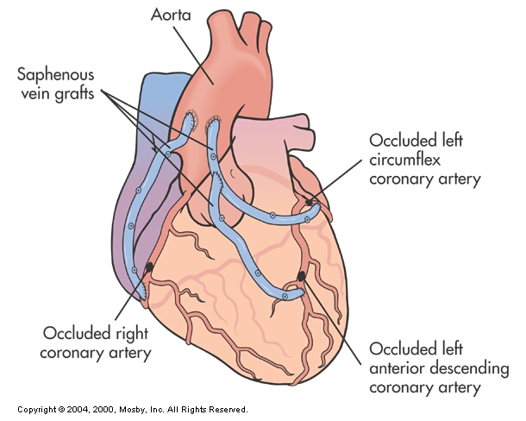
Common Cardiac Surgeries of Patients on 3C
Coronary Artery Bypass Graft (CABG)
  On pump
    The most precise approach for surgeons in anatomy.
    Risks on by-pass machine:
      Heparin: Increased risk of bleeding.
      Need for volume: Fluids given are third-spaced and extravasated. (vasoplegia)
  Off-pump
  (OPCABG)/Robotic CABG
    Most beneficial approach for the patient; no need for bypass.
    Only for visible anatomy; LAD is easily stentable.
    More complex surgery for the surgeon but fewer complications for the patient.
Notes:
All patients go through the process of determining if they’re candidates for off-pump; if the anatomy isn’t easily stentable, then patients go on-pump. Anatomy determines whether the patient can do on or off-pump.
By-pass pumps blood throughout the body with a machine; however, it’s inefficient enough to pump throughout the entire body.
- Heparin: Increased risk for bleeding and kidney injury risks.
Incisions: Mediastinal for on-pump; left thoracotomy for off-pump; however, it’s more painful.

Slide 4
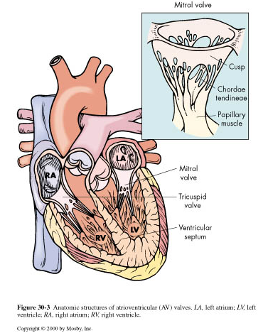
Common Cardiac Surgeries of Patients on 3C
Valve repair/ replacement
  Traditional via sternotomy
  Transcatheter aortic valve replacement (TAVR)
  Risks: Hypertension and heart block

Slide 5

CABG
Over 500,000 surgeries performed a year in the U.S. alone in 2024
Candidates for surgery:
  angina, with > 50 % occlusion of the left main coronary artery that can not be stented
  Unstable angina with severe two-vessel disease, moderate three vessel
  Ischemia with heart failure
  Acute MI with cardiogenic shock
  Coronary vessels unsuitable for PCI
Notes:
Reference: Ignatavicius, D. D., & Workman, M. L. (2016). Medical-surgical nursing: patient-centered collaborative care (8th ed.). St-Louis, MO: Elsevier.
https://pmc.ncbi.nlm.nih.gov/articles/PMC10807854/#:~:text=INTRODUCTION-,Coronary%20artery%20bypass%20grafting%20(CABG)%20is%20the%20most%20commonly%20performed,in%20the%20United%20States%20alone.
- 2024; same amount.

Slide 6
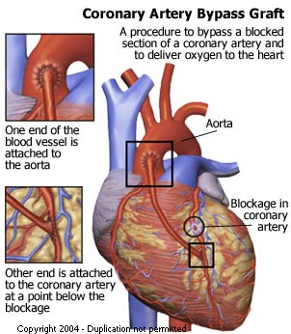
Critical Care Nursing Clinics of North America. South, Tabitha, BSN, RN. Published December 1, 2011. Volume 23, Issue 4. Pages 573-585. © 2011. Fig. 1 Coronary artery bypass graft. Available at: http://www.heartonline.org/Coronary%20Bypass%20Surgery.htm . Accessed December 15, 2010
Notes:
Bypasses a blocked section of the coronary artery
One section is attached to the aorta
Other section is attached to the coronary artery past or below the blockage

Slide 7
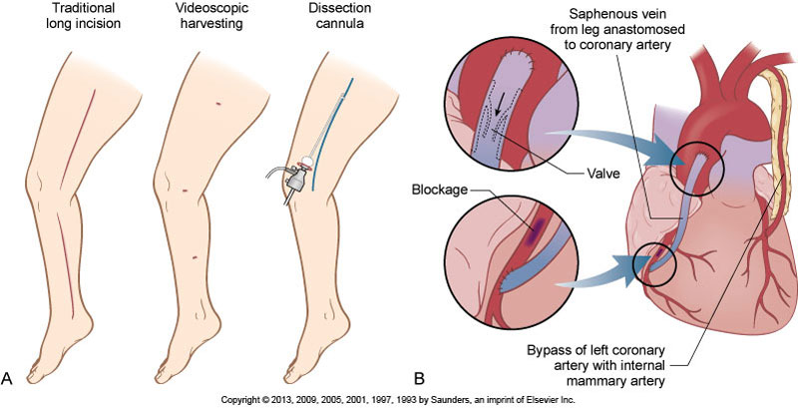
Coronary artery bypass graft surgery. A, Saphenous vein is harvested from the leg using either a traditional long incision or less invasive videoscopic harvesting. B, The vein is then anastomosed to the coronary artery.
Notes:
- Vein harvest from saphenous or left internal mammary vein from chest. (anastomsed)
Saphenous vein: Better for multiple vessels; LIMA cannot extend to the other arteries.
Left internal mammary artery: For longevity of the graft (1 vessel)
LIMA and saphenous can both be harvested
LIMA to LAD is the most common; highest survivability
Can also use other radial arteries or veins
Radial for longevity
Radial for younger patients

Slide 8
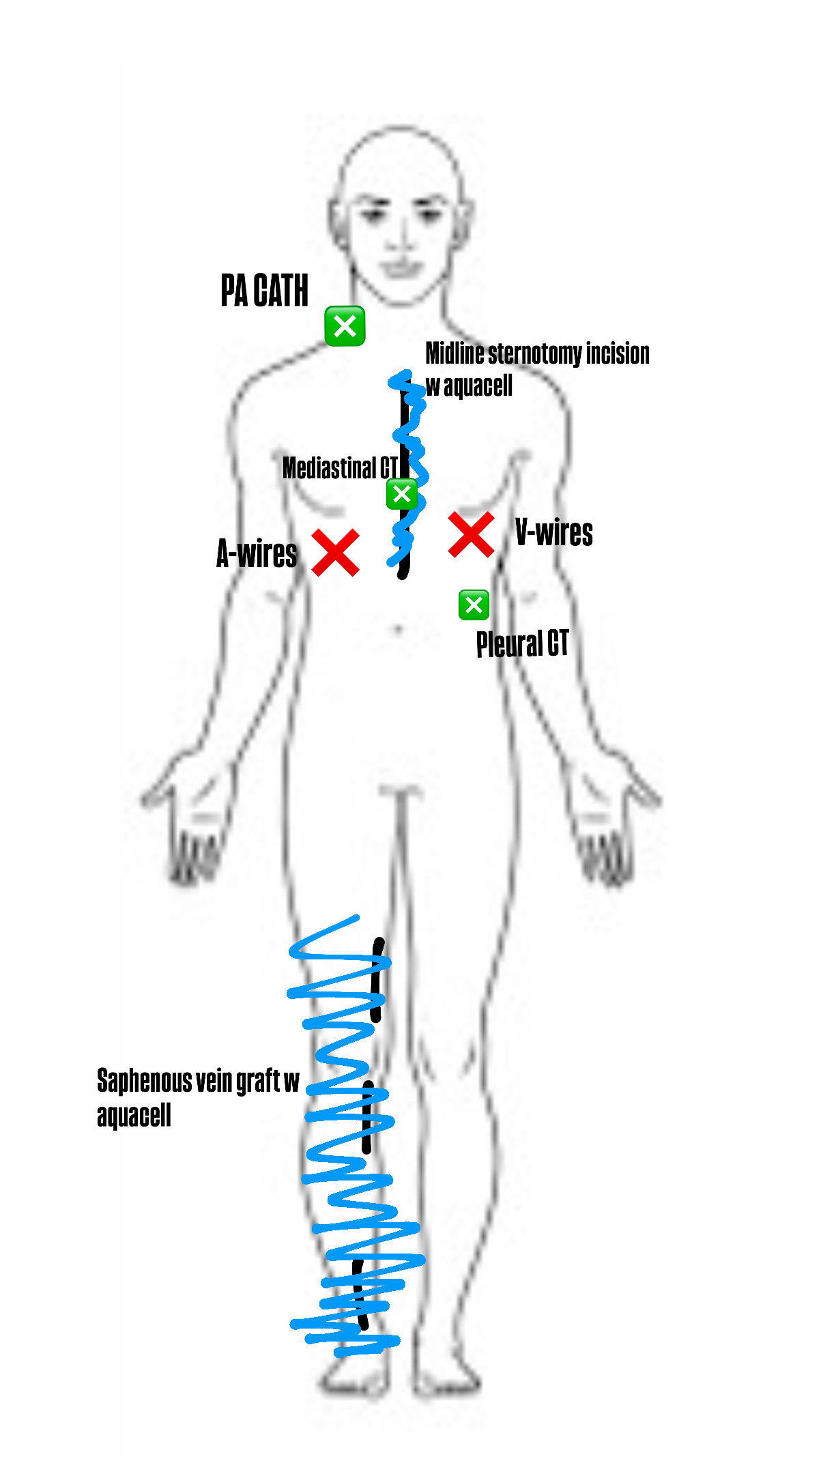
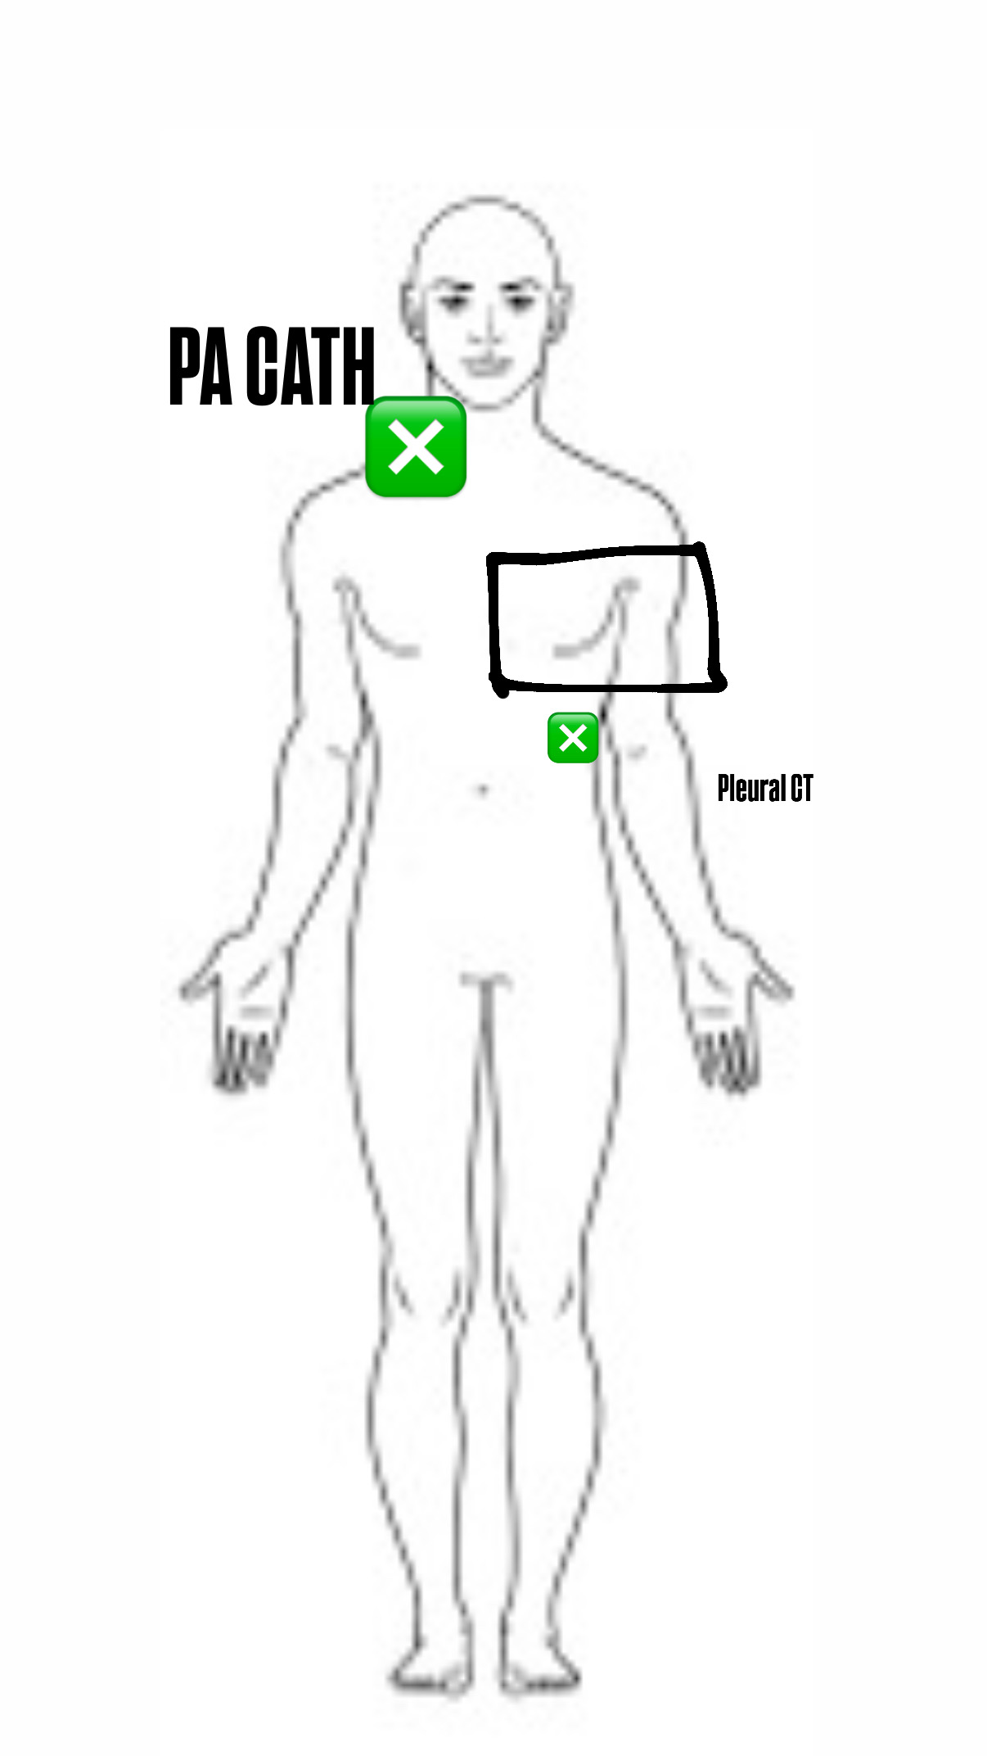
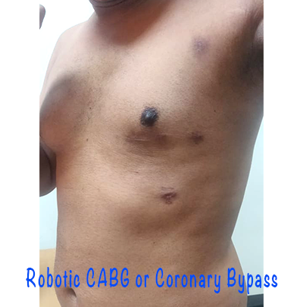
On-pump
Off-pump
ACE wrap
Notes:
Bring aquacell dressing to class
Mediastinal CT is where majority of the bleeding will come from.
- Pleural CT is blood that leaked into pleural space of lung.

Slide 9
CABG Postop Complications
  Bleeding
    HIT (monitor platelet ct)
    Mark CT level when the patient comes out.
  Fluid and electrolyte imbalance
    Edema, hypovolemia
    When vascular tone is intact, diuresis them to admission weight (day 2 s/p)
  Dysrhythmias
    Ectopy, atrial fibrillation
      Caused by cardiac irritation/diuresis too fast
  Neurologic deficits: Prevent delirium
    Restart neurological medications ASAP if they have a psych history.
  Graft failure/occlusion
    Monitor for chest pain!
  Postpericardiotomy syndrome
    Febrile inflammatory illness, caused by an autoimmune response to damaged cardiac tissue
      Reduce inflammation
      Monitor for fever; pleuritic plain
    More common in off-pump CABG procedures
Notes:
HIT- heparin induced thrombocytopenia with low platelet count, causing decreased clot formation, bleeding
Suspect HIT if platelets begin trending low post-surgery
Electrolyte imbalances
-causing dysrhythmias, cardiac irritation
Graft failure/occlusion of bypass grafts
Postpericardiotomy syndrome - treatment involves reducing inflammation with medications such as colchicine or ibuprofen. May result in life-threatening pericardial tamponade due to a progressively increasing pericardial effusion. S/s: Patients may be febrile, tachycardiac, have pleuritic pain, and a pericardial friction rub.

Slide 10

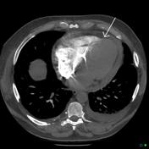
CABG Postop Complications
  Cardiac Tamponade
    Beck’s Triad (3 Ds)
      Decreased blood pressure
      Distant heart sounds
      Distended jugular veins
    Tachycardia, SOB, decreased LOC
    Anticipate trip back to OR/pericardial window.

Slide 11
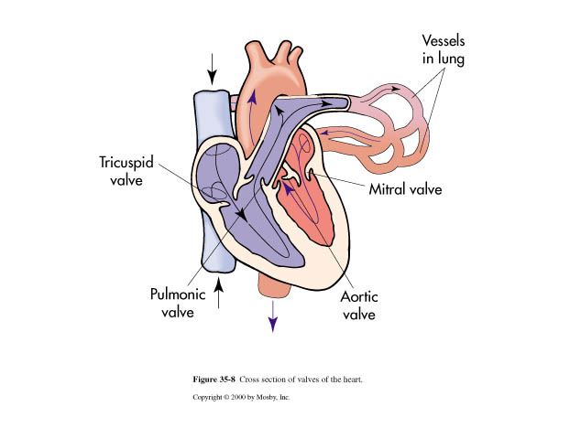
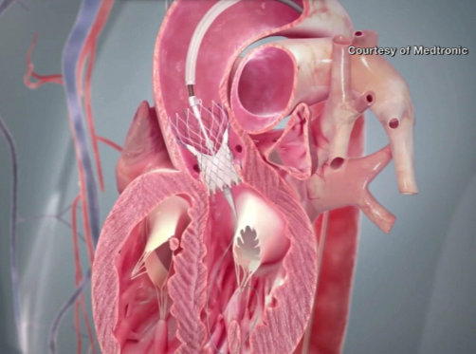
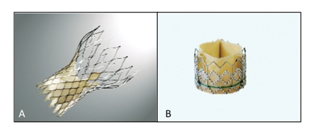
Valve Repair/Replacement

Slide 12
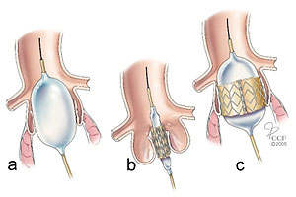
TAVR
What is it?
  Percutaneous aortic valve replacement through the femoral artery
  Used for severe symptomatic aortic valve stenosis
Who is eligible?
  Elderly, fragile patients who are not eligible for surgery
Valve is made of cow pericardium and supported with a metal stent
(Cleveland Clinic, 2015)

Slide 13
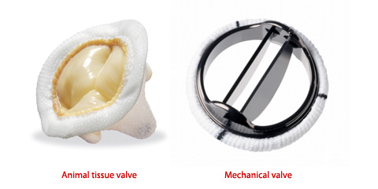
Potential Valve Postop Complications
In addition to CABG potential complications:
Endocarditis
  Chills
  Fever
  Fatigue and weakness
  Joint pain
  Poor appetite and weight loss
Bleeding
  Therapeutic anticoagulation
  Two finger lengths above the incision!
TAVR
  TIA/CVA
  Atrial fibrillation
  Heart block
    May need pacemaker
    Take BP for a suspected block!
      May need transvenous to transition to PPM
  HTN
    More prone d/t new increased pressure!
Notes:
Stiff door analogy.
§ Once you replace the hinges, it’s easy to open the door, and you don’t need as much pressure.
§ Your body is still adjusting from the high previous pressure used on the stenosed valve.

Slide 14
General Patient Profile from MSICU to 3C
Stable condition
Sternal and leg incisions
  ACE wrap removed s/p day 1
  Aquacell dressing removed after seven days
Able to ambulate
Epicardial pacer wires
  Removed 2-3 days after procedure; bedrest 1 hour s/p removal
Edema, fluid shifts
  CT surg commonly wants them net negative (-500 mL to -1 L) to admission weight.
Chest tubes
  Pleural comes out first before mediastinal.
  Removal based on patient output.
MSICU:
  V-wires and A-wires present
  Chest tubes
  PA catheter
  Intubation, on pressors, and paced
IICU
  V-wires and A-wires present
  Chest tubes
3C
  V-wires, A-wires, and chest tubes are discontinued.

Slide 15
You take a report for a patient with a CABG in 3C; the off-going nurse reported that your patient was slightly sleepy this morning.
You take multiple blood pressures, and it’s reported as 85/79, you also notice your patient’s HR is increasing.
Do you suspect shock? What do you do?

Slide 16
Nursing Management and interventions
  Prevent pulmonary complications
    I/S + cough d/b
  Monitor V/S
    Potential BP med changes
  Monitor I&Os and daily weights
    Diuretics as needed
  Prevent incision infection, monitor for fever
  Prevent DVT, early ambulation, and mobility
  Prevent electrolyte imbalance
  Appropriate pain and anxiety management
    Pain and anxiety control eases process of opening up lungs
  Monitor telemetry for rhythm changes
  Monitor neurological status.
Notes:
IS, mobility, CDB
Incision care – dressing in place for 7 days, afterwards daily care with betadine
Mobility, SCDs
Monitor K, Mag. Replace per PRN orders or notify MD
Pain management before moving patient
Monitor temps
Compare telemetry strips. Risk of afib/flutter or heart blocks.

Slide 17
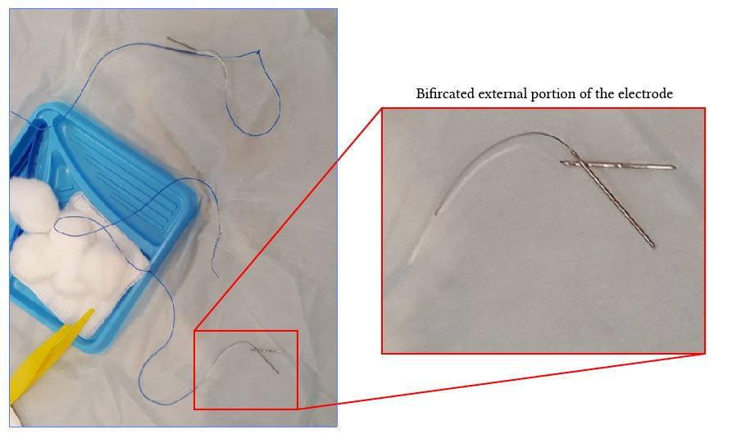
Pacer Wire Care
Epicardial lead wires are placed during surgery and remain in until discharge or no longer needed.
Be sure wires are easily accessible at emergencies
  Opsite with date, time, initials, V-wires or A-wires
Notes:
Epicardial wires wrapped on the tip of the glove if no sponge is given by OR.

Slide 18
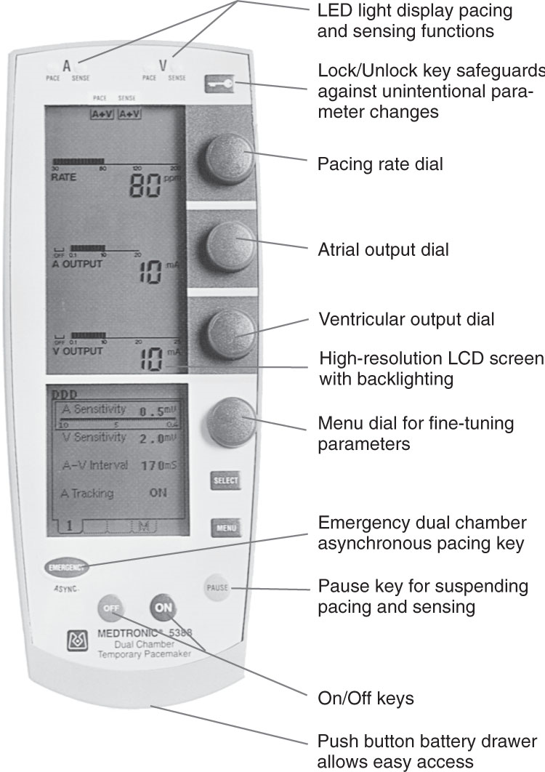
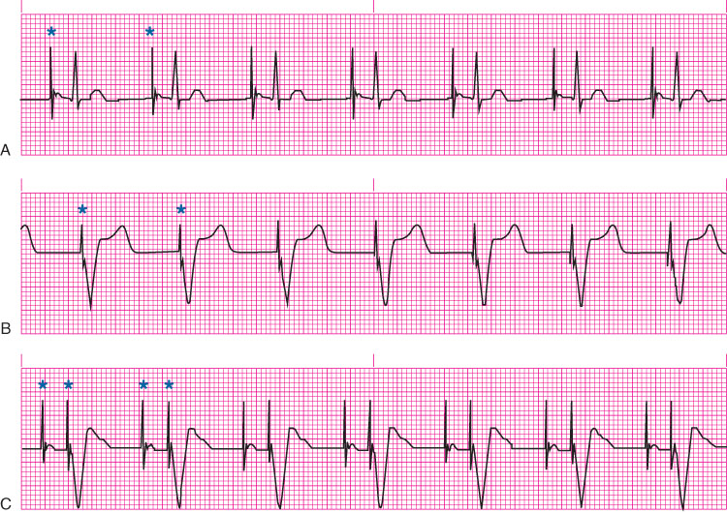
Temporary Pacing using Epicardial Leads
Pacing examples. A, atrial pacing, B, ventricular pacing, C, atrioventricular sequential (dual-chamber) pacing. (From Urden, L.D., Stacy, K.M., Lough M.E. [Eds.]. (2018). Critical care nursing: Diagnosis and management [8th ed]. Maryland Heights, MO: Elsevier.)
LED, light-emitting diode; LCD, liquid crystal display
Dual-chamber temporary pulse generator.
(Courtesy of Medtronic, Inc., Minneapolis, MN.)
Notes:
Overtime, mA and mV need to be adjusted for patient’s needs

Slide 19
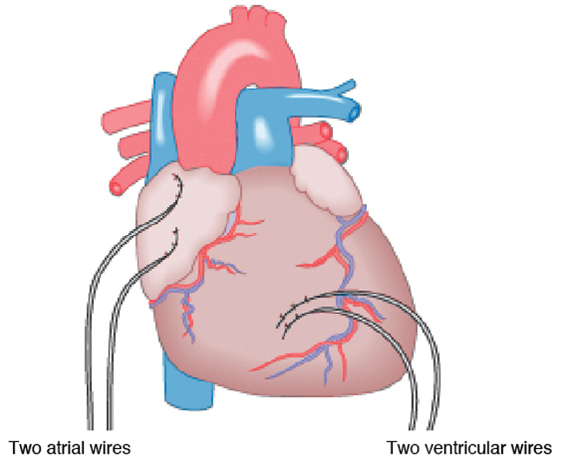
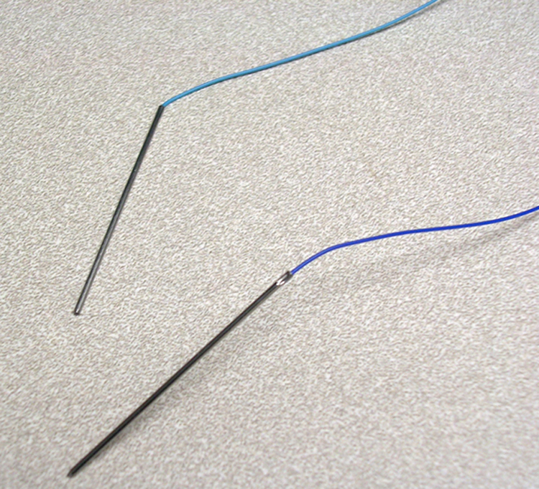
Temporary Pacing using Epicardial Leads
Location of atrial and ventricular epicardial lead wires. (From Wiegand, D.L. [Ed.]. [2017]. AACN procedure manual for high acuity, progressive, and critical care [7th ed.]. St. Louis: Elsevier.)
Epicardial pacing wires. (From Wiegand, D.L. [Ed.]. [2017]. AACN procedure manual for high acuity, progressive, and critical care [7th ed.]. St. Louis: Elsevier.)
Notes:
Should we do demonstration on pacemakers?
DDD mode

Slide 20
Medications
Diuretics
  Furosemide
Cardiac
  ACE inhibitors
    Lisinopril
  Beta-blockers
    Atenolol
  Calcium channel blockers
    Amlodipine
  Antiarrhythmics
    Amiodarone
  Nitrates
    Isosorbide mono/dinitrate
Electrolyte replacement
  K+
    Goal generally >4.2
  Mg++
    Goal generally >2.0
  Advocate for replacement!
Warfarin
  Monitor INR
Glucose control
  Insulin
  Oral antidiabetic agents
    Metformin

Slide 21
Discharge Planning
All lines removed, pacer wires removed by MD
  Pt to remain on bedrest x1 hr after pacer wires removed, VS q15 minx4- BP/HR
  Prevent cardiac tamponade
Discharge medications
Follow up appointments
Notes:
Pacer wires normally are taken out 2-3 days after being on 3C. Pt is on bedrest 1 hour after the pacer wires are pulled out.
S/S of cardiac tamponade: Beck’s triad: hypotension, muffled heart sounds, JVD
3 D's:
Distant heart sounds
Distended jugular veins
Decreased arterial pressure

Slide 22

Discharge planning
Patient education
  Diet
  Incision care
    Prevent infection
  Activity and exercise
    Sternal precautions!
  Mood changes

Slide 23
You walk into your s/p TAVR patient’s room, and he says, “I think I peed myself.” You check underneath the blankets, and you see blood oozing from his groin incision; what’s your immediate action?
Administer blood
Cycle a blood pressure and put pressure on the groin incision
Cycle a blood pressure and put pressure above the groin incision
Put a mepilex over the incision.

Slide 24
QUESTIONS

