Slide 1

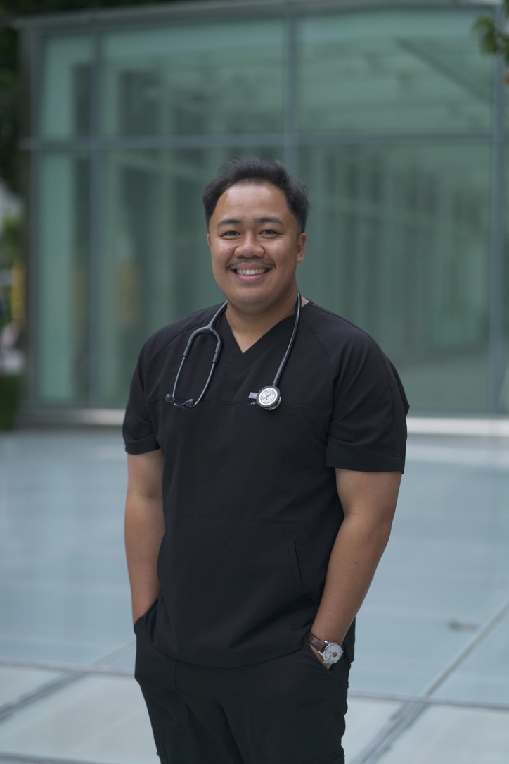

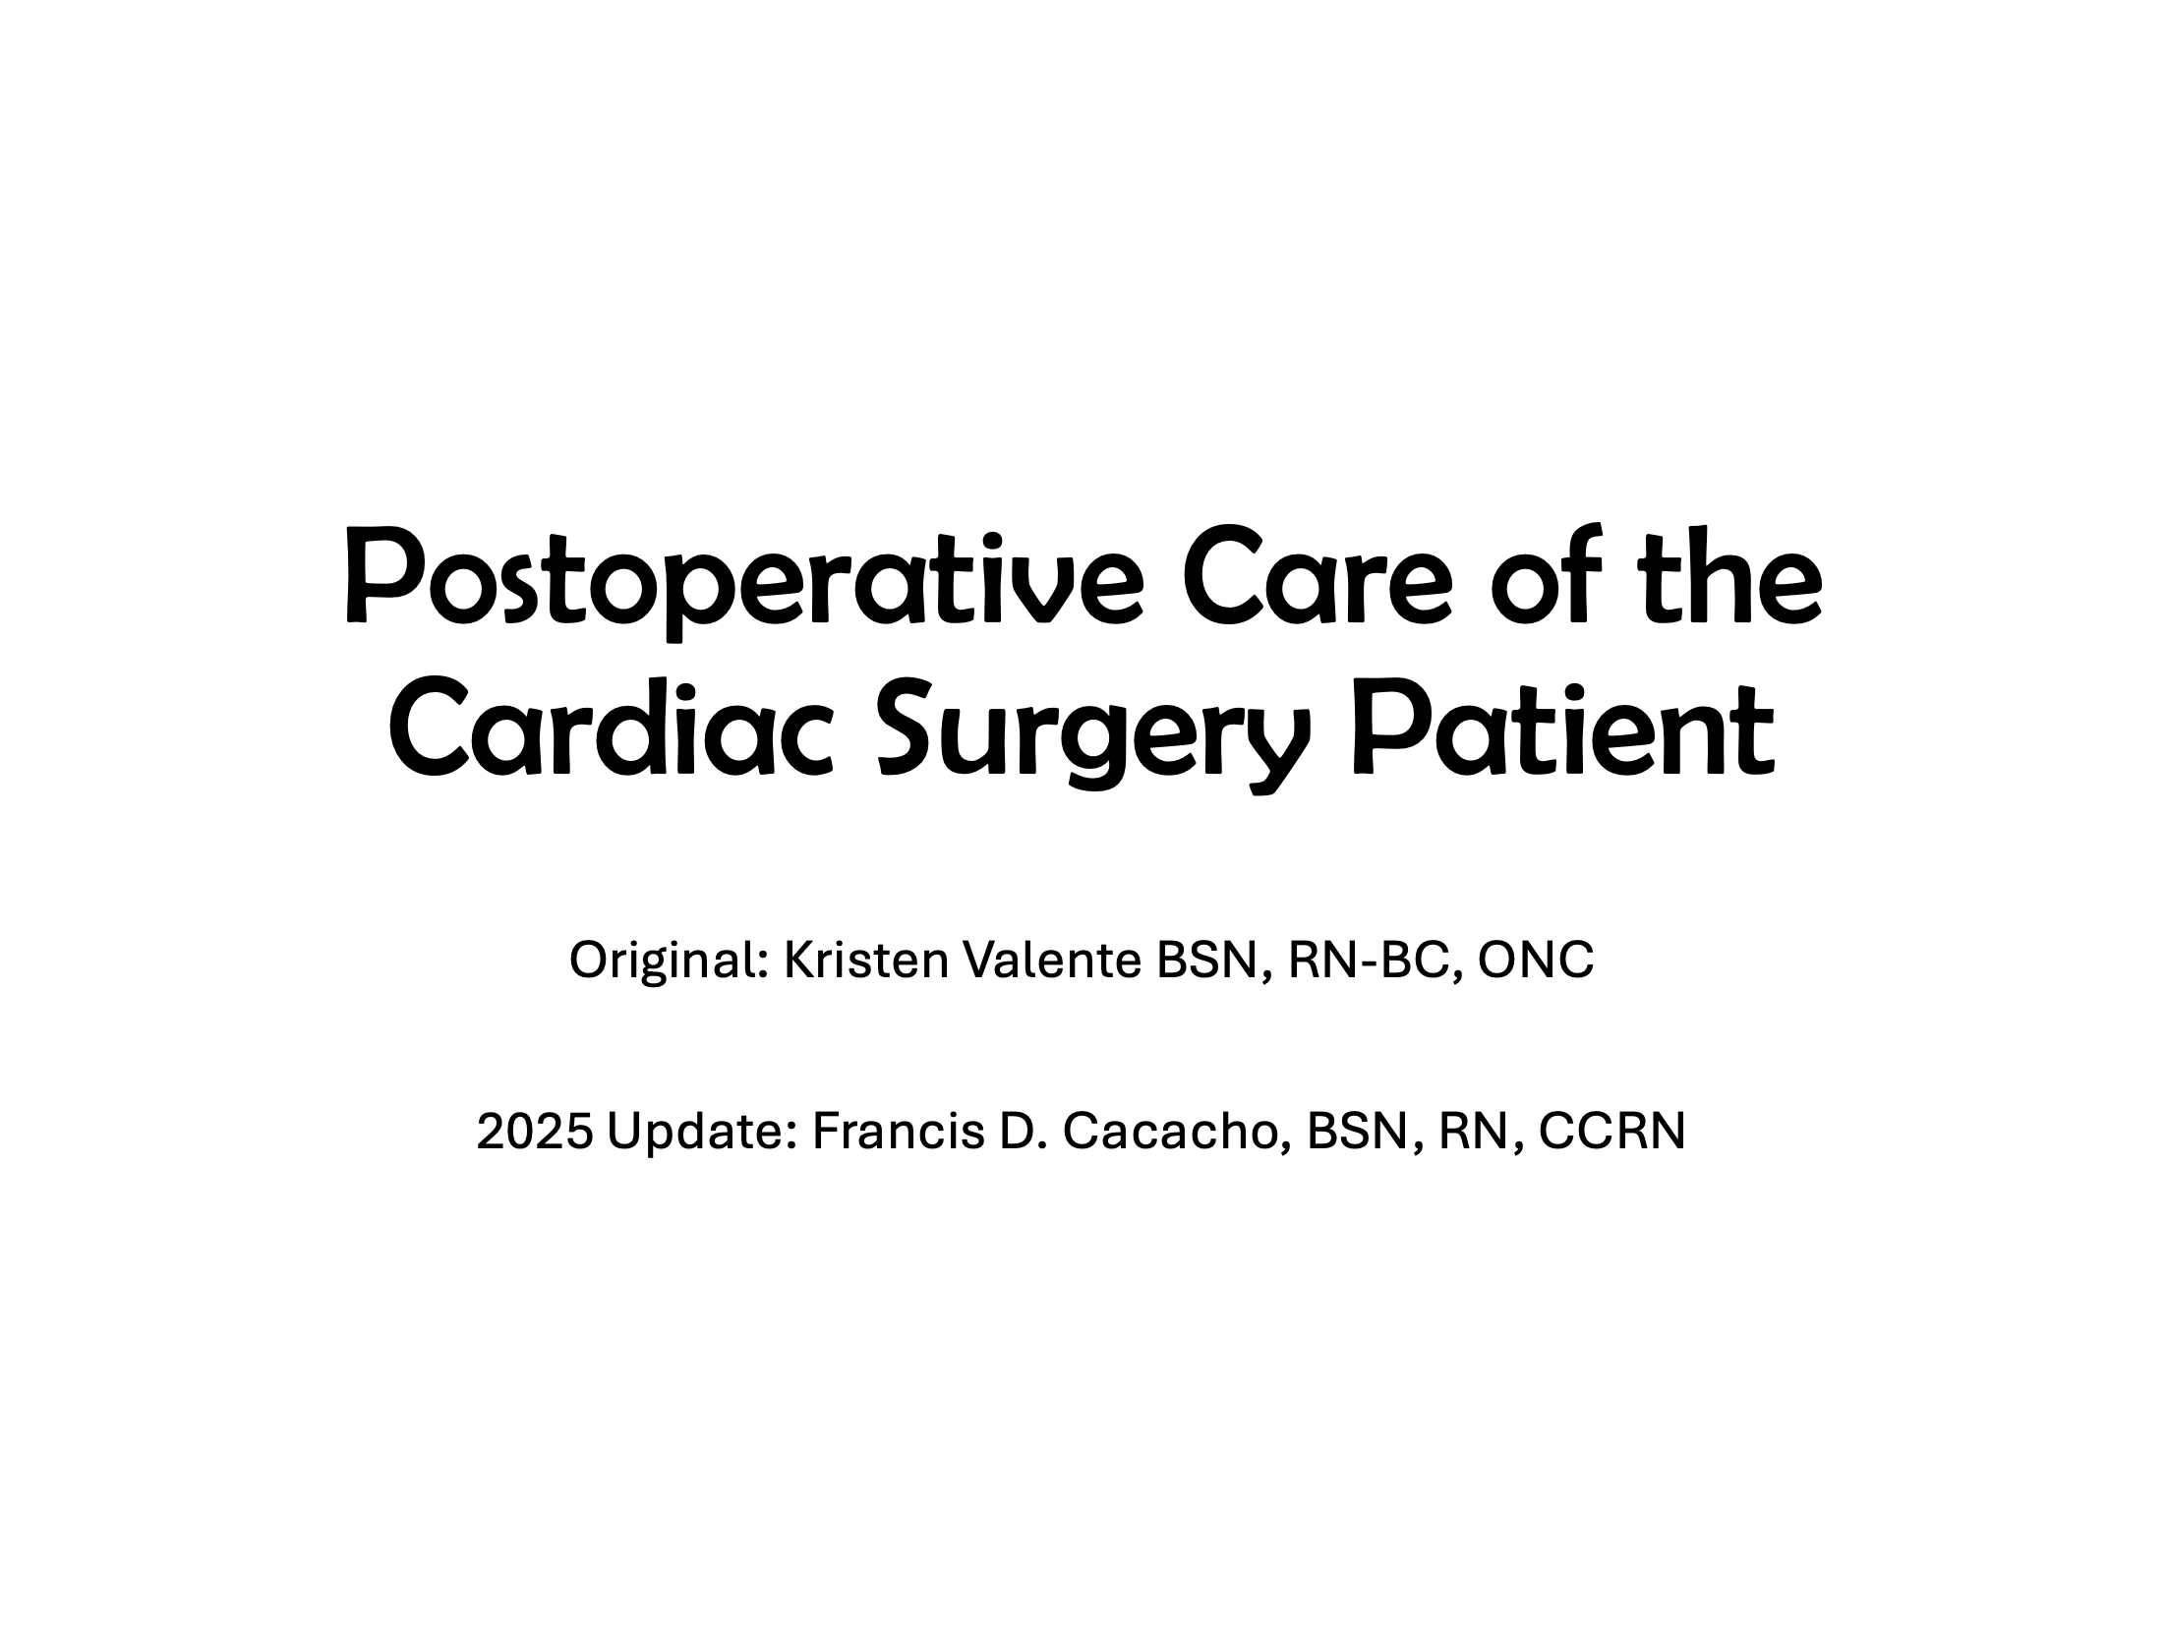
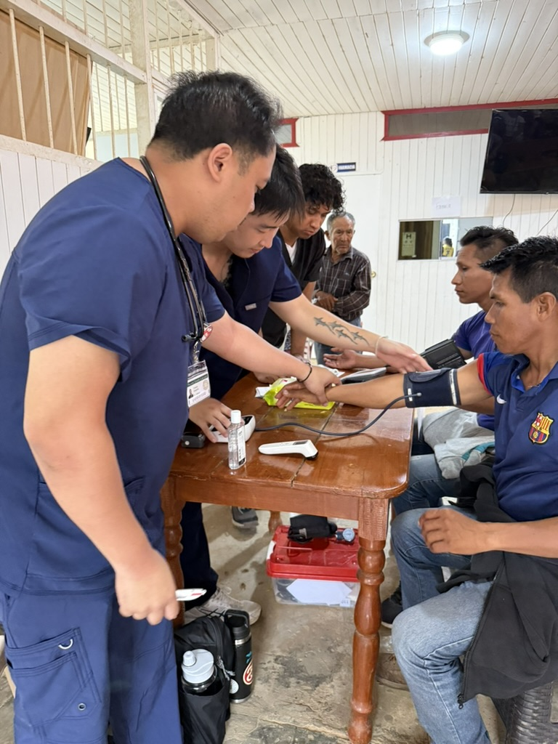
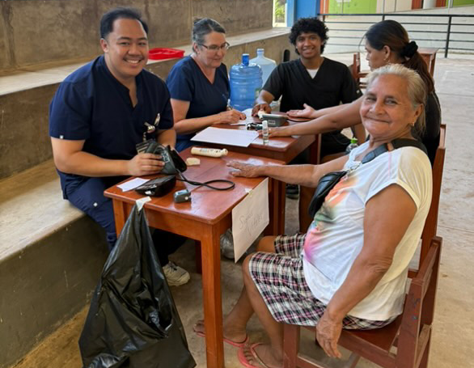
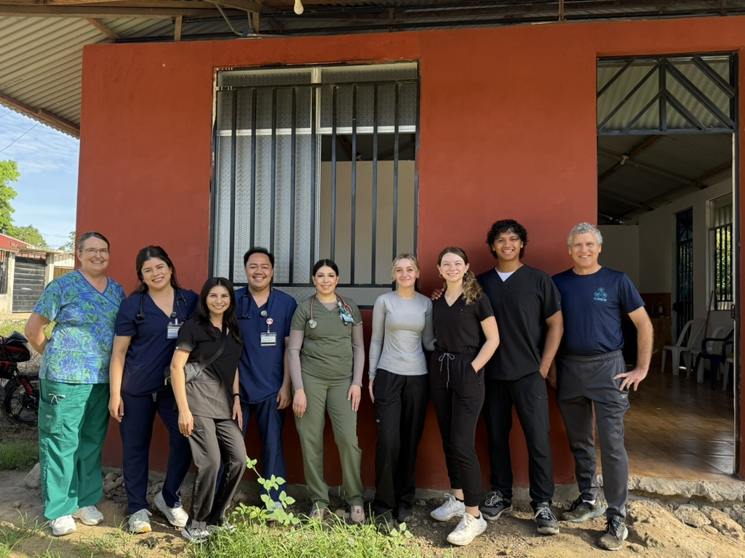
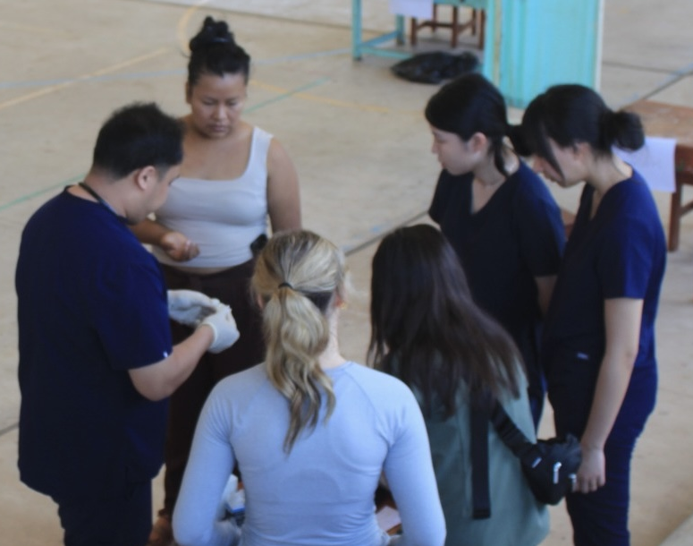

Francis D. Cacacho, BSN, RN, CCRN
NURS 592 MSN Education Capstone| Laurie Parson, DNP, RN-BC, CNE
Student Learning Outcomes: “WISDOM”
W: Wholeness – Make mature, independent choices integrating the needs of body, mind, and spirit.
  Nursing care is not just about treating the symptoms in front of us; while on a mission trip to Peru, nursing choices also consider the home life of patients and provide education to maintain wellness.
I: Integrity – Live lives based on the highest ethical standards.
  The highest ethical standards are set in my nursing practice through following Jesus’ philosophy of selflessness. Selflessness is not thinking less of yourself, but instead thinking of yourself less.
S: Service and Stewardship – Practice the Biblical imperatives to serve humanity, resist injustice, and care for the created world.
  If the pathophysiology and pharmacokinetics tell us how things happen, God tells us why.
D: Diversity, Equity, and Inclusion – Display intercultural competency and global understanding as informed members of a dynamic global church and world community.
  While caring for and educating patients in the US, encountering patients during the Peru mission trip made me realize that God’s love is universal—the beauty of understanding how different cultures express their love for God.
O: Our Adventist Heritage – Understand and value the major tenets of Seventh-day Adventist Christian thought, including the blessing and significance of the Sabbath.
  Parable of the Talents – God gave us gifts to incorporate into different acts of caring.
M: Maintaining Lifelong Learning – Continue the intellectual skills and curiosity necessary to learn and grow creatively throughout life.
  Aside from continuing education obtained through the CCRN, learning from my mentors about how to approach and navigate the nursing profession has helped me advance my career.
MSN Program Outcomes:
Demonstrate the use of scholarly inquiry to evaluate current knowledge from nursing theory, nursing science, and related principles to inform and/or change in nursing practice.
  Updated an outdated PowerPoint regarding the nursing care for common post-op cardiac surgeries to the most current practice for my surgical principles class. I’ve also developed lesson plans for teaching classes at PUC, utilizing my current ICU experience to enhance class topics, including CAD pharmacology and its associated nursing care.
Apply ethical decision-making to nursing practice.
  While taking vital signs in Peru, I encountered a situation where I believe a patient needed to be seen before others due to the severity of her symptoms. The patient ended up being emergently transported to the hospital from the clinic due to pericardial effusion.
Analyze the effect of health policy, finance, technology, and the organizational context on the development and implementation of quality nursing practice.
  While I was in Peru, I was in an uncontrolled environment regarding health policy, finance, technology, and organizational context, which impacted the quality of nursing practice. Although it differed from a hospital setting in the US, it was essential to emphasize and understand how approaches to nursing care differed from those in the United States.
Demonstrate the use of leadership strategies that advance the design, implementation, and evaluation of nursing practice.
  When running the vital signs station in Peru, I’ve taught numerous students how to take vital signs and provided instruction in clinical scenarios when we encounter patients with abnormal vital signs.
Analyze the effect of sociopolitical, cultural, and global influences on nursing practice.
  Meetings with the healthcare team at the Peru clinic made me realize the education I needed to provide to patients due to the influences in their environment. This is related to their diet and living situations.
Utilize interprofessional communication to improve healthcare outcomes.
  Collaborated with NPs, MDs, and pharmacists regarding the current nursing care for common post-op cardiac surgeries for my surgical principles class.
Integrate advances in technology into healthcare
  Provided teaching for my hospital regarding new technology, including hubless narcotic IV tubing to prevent the risk of inappropriate access to narcotics.
Nursing Educator Outcomes
Demonstrate professional role competencies of nursing education through teaching and learning of advanced practice principles and theories.
  Applying the concepts of Malcolm Knowles’s theory of andragogy, or the adult learning theory, while facilitating a post-conference clinical case study, emphasizes individuality in correlation with the Parable of the Talents.
Analyze trends in healthcare and nursing education in the development of nursing curricula, teaching methodologies, and evaluation strategies in the classroom or the clinical education setting.
  The current trends in healthcare are going towards artificial intelligence (AI). In my nursing practice, I emphasize the use of technological advances to help nurses provide quality care; however, it’s essential to note that technology will never replace the therapeutic communication that requires emotional intelligence to be provided to patients.
Facilitate learning of individuals and groups using theories of education, nursing, testing and evaluation, and technological innovation.
  Following the theories of Socratic questioning while facilitating a post-conference clinical case study encouraged students to think critically, helping to mold their critical thinking skills.
Use technology to educate and facilitate learning to improve outcomes of all populations.
  Adapting to the environment around me, I’ve used PowerPoint and YouTube to help facilitate teaching to environments in the US. In Peru, the use of translators, pamphlets, and Google Translate on mobile devices helped encourage teaching across language barriers.
Apply leadership strategies in the development of nurse educators.
  While teaching classes at PUC with my mentor, one of the strategies I’ve utilized was acknowledging the perspectives they hold. This helped me serve as a role model by telling stories that relate to their clinical experiences.
Demonstrate competency in evaluating research to improve nursing practice and nursing pedagogy.
  Throughout the MSN program, I’ve taught students of various age groups. Researching differences between generations helped me utilize strategies differently. I also reviewed the current evidence-based practice articles related to updating practices on post-operative cardiac surgery care for my surgical interventions class. I have also collaborated with a group of two MSN students on developing the best nursing curriculum centered on health and wellness.
Apply strategies that recognize multicultural factors in teaching and learning.
  In Peru, one of the significant characteristics regarding barriers in teaching was language barriers. It was essential to emphasize to others the importance of keeping translations simple to facilitate direct communication and to convey a sense of compassion through correct body language, demonstrating a genuine connection with the patient.
References: Pacific Union College, (2010). Values and student learning outcomes. https://www.puc.edu/about-puc/institutional-research/values-and-student-learning-outcomes
Notes:
You can add your presentation notes here. This presentation template for research posters is fully editable so text, graphics and content can be updated to fit your own research needs.
Download more poster presentation templates from FPPT.com

