Slide 1


Infective Endocarditis (IE): Information for Cardiac Nurses
By Francis Cacacho, BSN, RN, CCRN

Slide 2
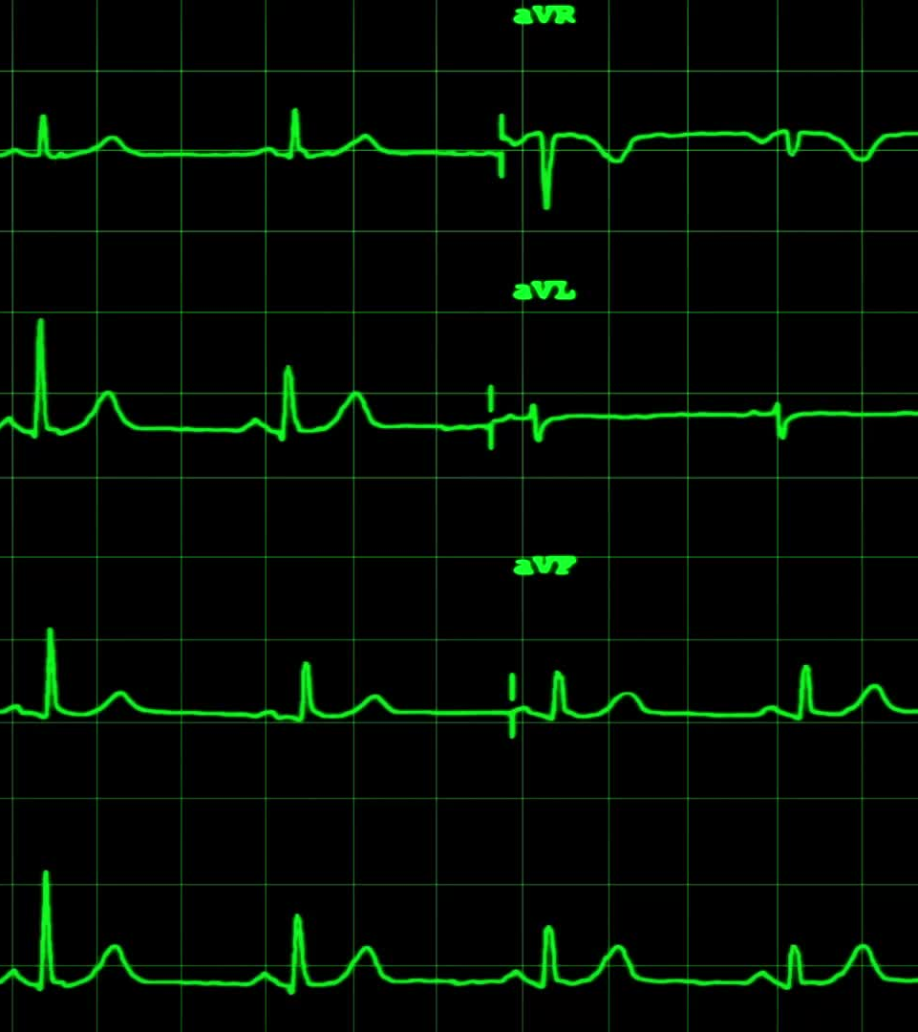
What is infective endocarditis?
A serious and life-threatening infection of the inner heart surface; more specifically, the valves (Norris & Tuan, 2020).
Invasion of the heart valves and endocardium leading to vegetations and destruction of underlying cardiac tissues (Norris & Tuan, 2020).
Learning the significance of infective endocarditis in a patient’s history helps nurses anticipate potential complications that may occur.

Slide 3

Risk Factors
Mitral valve prolapse and congenital heart diseases
Implantable devices:
Pacemakers
Defibrillators
Prosthetic heart valves
Behaviors:
IV drug use
Alcohol use
Recent dental surgeries
Host factors:
Neutropenia
Immunodeficiency
Malignancy
Therapeutic immunosuppression
Diabetes

Slide 4
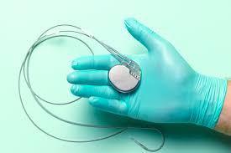
Why should nurses be concerned?
Patient population of implantable devices.
Essential to consider the functions of potentially infected implantable devices when doing patient care.

Slide 5
Question #1
As the primary nurse, your patient gets admitted to your unit for infective endocarditis. When reading your patient’s chart, you notice that he has an implantable defibrillator. As the primary nurse, why is it important to learn about implantable devices and endocarditis?
Implantable devices help prevent the vegetation of infective endocarditis from getting worse.
Implantable devices can serve as a risk for infective endocarditis due to it being a foreign object in the body.
Implantable devices can pose a risk for infective endocarditis because they can suppress the immune system.
Implantable devices prevent the progression of infective endocarditis because they amplify your immune system to prevent infections.

Slide 6
Pathophysiology (1/2)
1. Endothelial Injury or Inflammation (Initial Trigger):
Inflammation from sepsis or infection leads to endothelial injury.
2. Formation of Thrombotic Lesions:
Damaged endothelium has deposits of fibrin-platelet aggregates on the valves.
Non-bacterial thrombotic endocarditis

Slide 7
Pathophysiology (2/2)
3. Bacterial Colonization:
Bacteria then bind to the sterile fibrin-platelet aggregates on injured endothelium/valves.
4. Vegetation Formation and Maturation:
Bacteria + fibrin-platelet aggregates form vegetation
Vegetation is the pathological characteristic of IE:
Bacteremia, tissue invasion (hemodynamic compromise), embolization

Slide 8
Question #2
The student nurse asks you, the preceptor, a question regarding infective endocarditis and how it can lead to a myocardial infarction (MI). What is the correct response?
  Vegetation from a valve in the heart can break off and form a clot.
  IE facilitates the plaque formation of CAD and forms a clot.
  IE causes the coronary arteries to constrict due to the inflammatory response.
  IE can cause a higher turbulent blood flow, which can result in breaking off old clots to serve as emboli.

Slide 9


Genetic Influences
Compared to cancers, there aren’t any genetic factors that put someone at risk for infective endocarditis.
Genetics plays a role in the phenotype of someone’s immune system that exposes them to certain microbes for infections that can lead to infective endocarditis (Eduardo Alvarado Rubio MD et al., 2019).

Slide 10
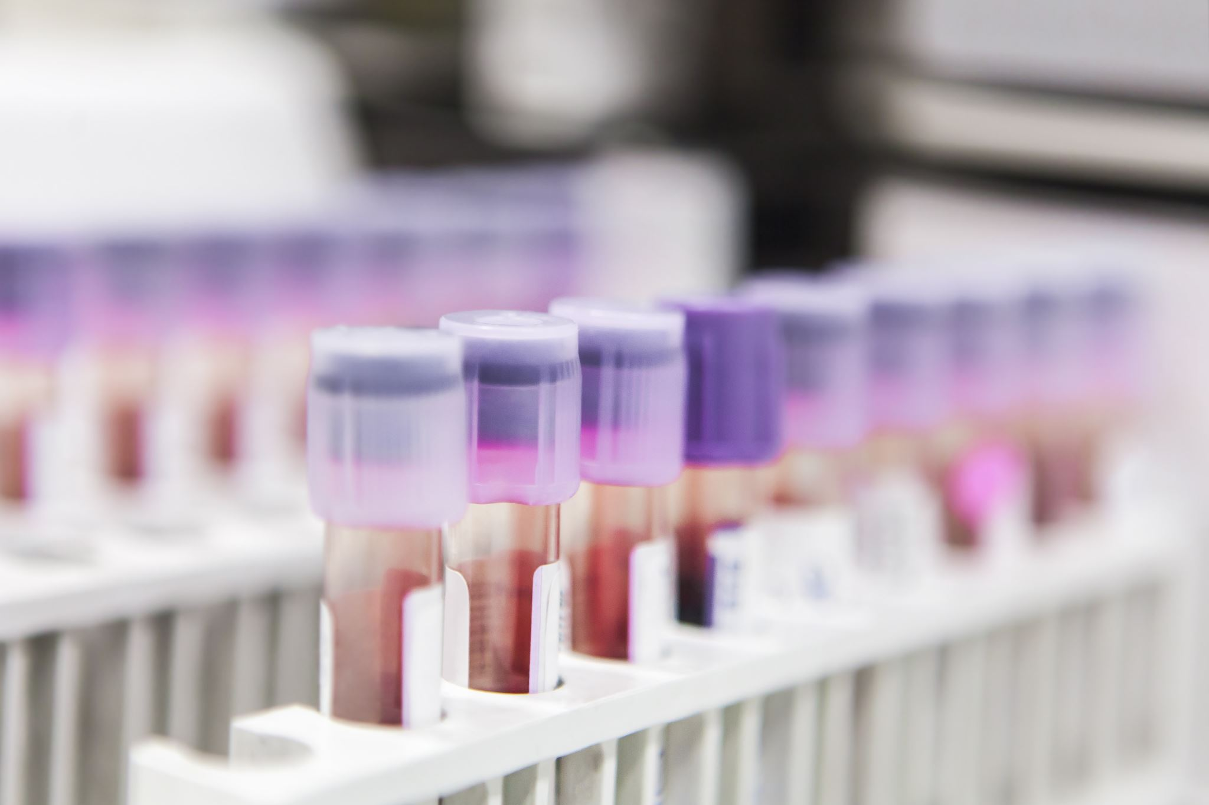
Lab Work Diagnostics
Blood cultures are the most definitive diagnostic procedure:
  Three sets of blood cultures need to be obtained from three different sites within 24 hours (Norris & Tuan, 2020).
Anticipated lab work (NewYork-Presbyterian, 2025):
  Complete Blood Cell Count (CBC): A high WBC count indicates an infection
  C-reactive protein test (CRP): Indication of this states heart inflammation
  Troponin: Elevated troponin indicates cardiac tissue injury

Slide 11

Other Diagnostics
Echocardiogram:
  Detecting vegetations
  Detecting cardiac complications as a result of IE (Norris & Tuan, 2020).
Electrocardiogram (EKG)
  No specific abnormalities will appear on an EKG unless the extent of IE gets worse and affects heart function (NewYork-Presbyterian, 2025) .

Slide 12
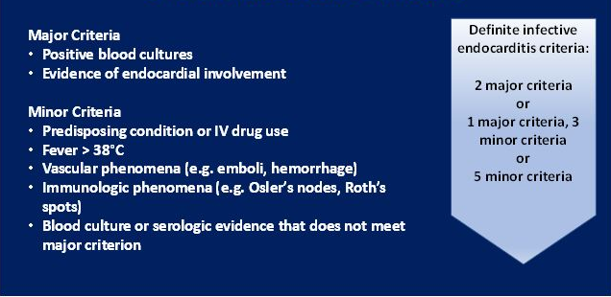
Duke Criteria

Slide 13
Question #3
As a charge nurse in your medical-surgical unit, which patient is at risk for infective endocarditis based on Duke’s Criteria?
75 y/o M admitted for COPD exacerbation with a blood pressure of 110/76.
45 y/o F admitted for SI with a temperature of 39 C and blood pressure of 121/78.
51 y/o F admitted for pain on her abdomen with positive blood cultures and abnormalities on her echocardiogram.
65 y/o M admitted for a cardiac workup with a history of IV drug use.

Slide 14
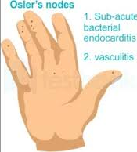
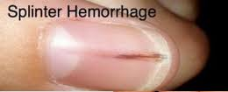
Clinical Manifestations
Initial:
Fever + Signs of systemic infection
Changes in existing heart murmurs
Evidence of embolic distribution of vegetative lesions
Acute form:
Spiking fever
Chills
Subacute form:
Low-grade fever
Systemic signs of inflammation:
Spleen enlargement
Anorexia
Malaise
Lethargy

Slide 15
Symptoms of Embolism Involvement and Complications
Systemic Emboli s/s:
Cough
Dyspnea
Arthralgia
Arthritis
Diarrhea
Abdominal or flank pain
Complications:
Congestive Heart Failure
Valve destruction
Myocarditis
Renal insufficiency
Myocardial infarction
Pulmonary Embolism
Stroke

Slide 16
Question #4
As the primary nurse, you’re taking care of a patient with a faulty prosthetic valve. As you’re doing your assessment, you look at your patient’s fingers and see a vertical red line going down his thumb with a temperature of 99 F. What should you do with these findings?
Nothing, this is an insignificant finding on the thumb, and the patient is probably just warm.
These are Osler’s nodes; they are indicated for IE, and with the low-grade fever, the MD must be notified immediately.
These are splinter hemorrhages, which are indicative of IE. With the low-grade fever, the MD must be notified immediately.
The patient is stressed due to his prosthetic valve; the thumb injury was likely an old issue he had years ago.

Slide 17
Treatment Plan
Minimizing and eliminating the microorganism (Norris & Tuan, 2020).
Antibiotics that correlate with the appropriate microbe.
Minimizing the residual cardiac effects (Norris & Tuan, 2020).
Diuretics can help with associated heart failure complications (Gupta, 2023).
Treating the pathologic effect of septic emboli (Norris & Tuan, 2020).
There isn’t strong support for the use of anticoagulants for septic emboli (Elsaghir, 2023).
Starting antibiotics soon and early surgical interventions are indicated (Elsaghir, 2023).
Ex. Pacemaker lead replacement for infected pacemakers, valve replacements, or surgical resections of emboli

Slide 18

Medication regimen for IE
Patients are indicated for aggressive IV antibiotic therapy with a central line.
Initial antibiotic therapy before the results of cultures come back (Tackling, 2023): Staphylococcus, Streptococcus, Enterococci
  Ampicillin + gentamycin + flucloxacillin or oxacillin
  Pencillin allergic: Vancomycin + gentamicin
Depending on what the microbe is, there are specific antibiotics for each microbe (Tackling, 2023).
  Pencillin
  Cephalosporins
  Aminoglycoside
  Glycopeptide

Slide 19
Question #5
As the primary nurse, you have a patient admitted for infective endocarditis. You draw blood cultures and are currently waiting for the results to come back. What orders do you anticipate from the doctor? Select all that apply.
Vancomycin 1000 mg IV Q8
Consult regarding surgery for a suspected infected pacemaker.
Heparin 5000 units SQ Q8
Orders to clean central line dressing Qweek or PRN if soiled

Slide 20
References
Cuervo, G., Escrihuela-Vidal, F., Gudiol, C., & Carratalà, J. (2021). Current challenges in the management of infective endocarditis. Frontiers in Medicine, 8. https://doi.org/10.3389/fmed.2021.641243
Eduardo Alvarado Rubio MD, P., Brugada Molina MD, R., Eduardo Alvarado Ávila MD, P., González Mora MD, A., & Augusto González López MD, C. (2019). Infective endocarditis: Inflammatory response, genetic susceptibility, oxidative stress, and multiple organ failure. Infective Endocarditis. https://doi.org/10.5772/intechopen.84908
Elsaghir, H. (2023, June 26). Septic Emboli. StatPearls [Internet]. https://www.ncbi.nlm.nih.gov/books/NBK549827/
Gupta, A. (2023, July 17). Endocarditis. StatPearls [Internet]. https://www.ncbi.nlm.nih.gov/books/NBK499844/
NewYork-Presbyterian. (2025). Endocarditis: Diagnosis & treatment. https://www.nyp.org/heart/heart-inflammation/endocarditis/treatment
Norris, T. L., & Tuan, R. L. (2020). Porth’s Essentials of Pathophysiology. Wolters Kluwer.
Tackling, G. (2023, April 10). Endocarditis antibiotic regimens. StatPearls [Internet]. https://www.ncbi.nlm.nih.gov/books/NBK542162/
University of Pittsburgh Department of Pathology. (2025). Diagnosis and discussion – Case 1077. Retrieved May 28, 2025, from https://www.path.pitt.edu/diagnosis-and-discussion-case-1077

